Slide 1
Development of the Brain
Pre-adolescence and adolescence

Slide 2
Adolescence …
Adolescence is defined as the transition from childhood to adulthood or the psychological, social and emotional changes that accompany puberty .

Slide 3
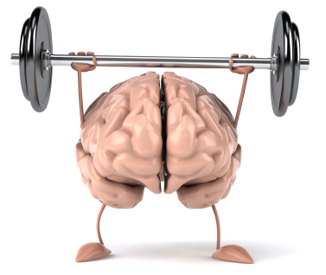
Brain Development Overview
It now appears the brain continues to change into the early 20's with the
frontal lobes, responsible for reasoning and problem solving, developing last.

Slide 4
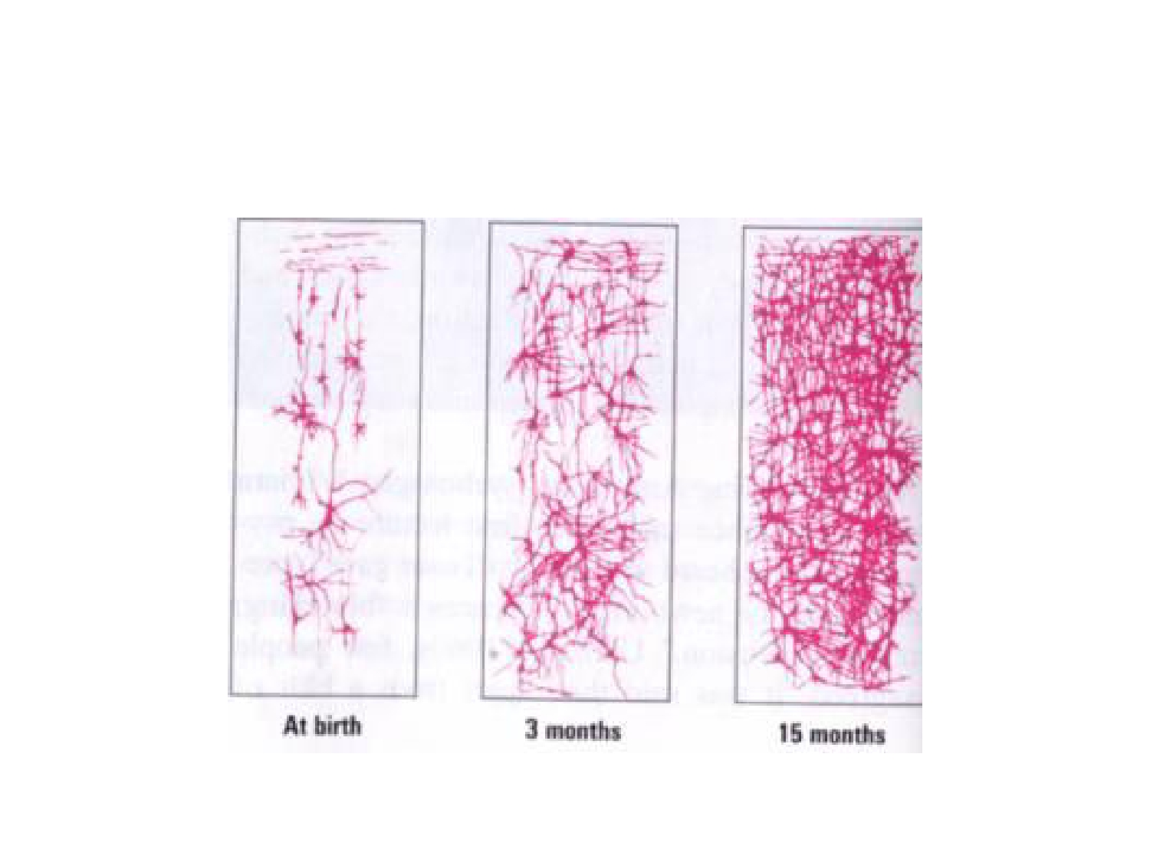
Neural Growth

Slide 5
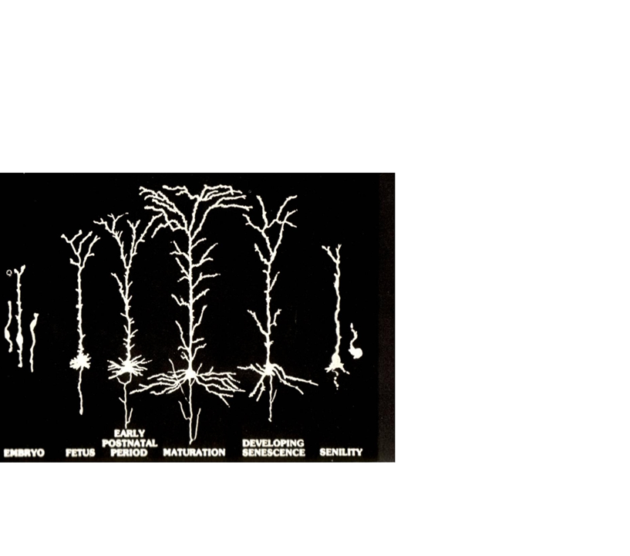
Synaptic Growth Spurt
Between ages 7 and 11,
the brain undergoes a huge spurt of growth of connections just like they were doing around 18 months to two.
Most of this growth is in
the temporal lobes and in the parietal lobes.

Slide 6
Temporal Lobes
The temporal lobes handle auditory information.
Deep down within the temporal lobes is a structure called the hippocampus, and it is responsible for memory.
The hippocampus is growing and developing rapidly
between the ages of 7 and 11.

Slide 7
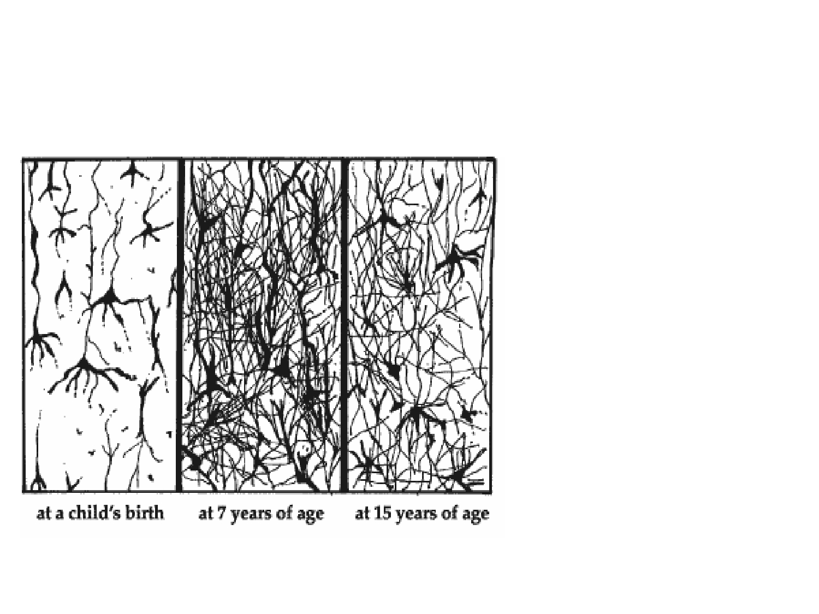
Synaptic Pruning
The first change after this synaptic growth
spurt is a selective pruning which takes place.
In adolescence, most of this pruning is taking place in the frontal lobes.
The adolescent loses approximately
3 percent of the gray matter in the frontal lobes.

Slide 8
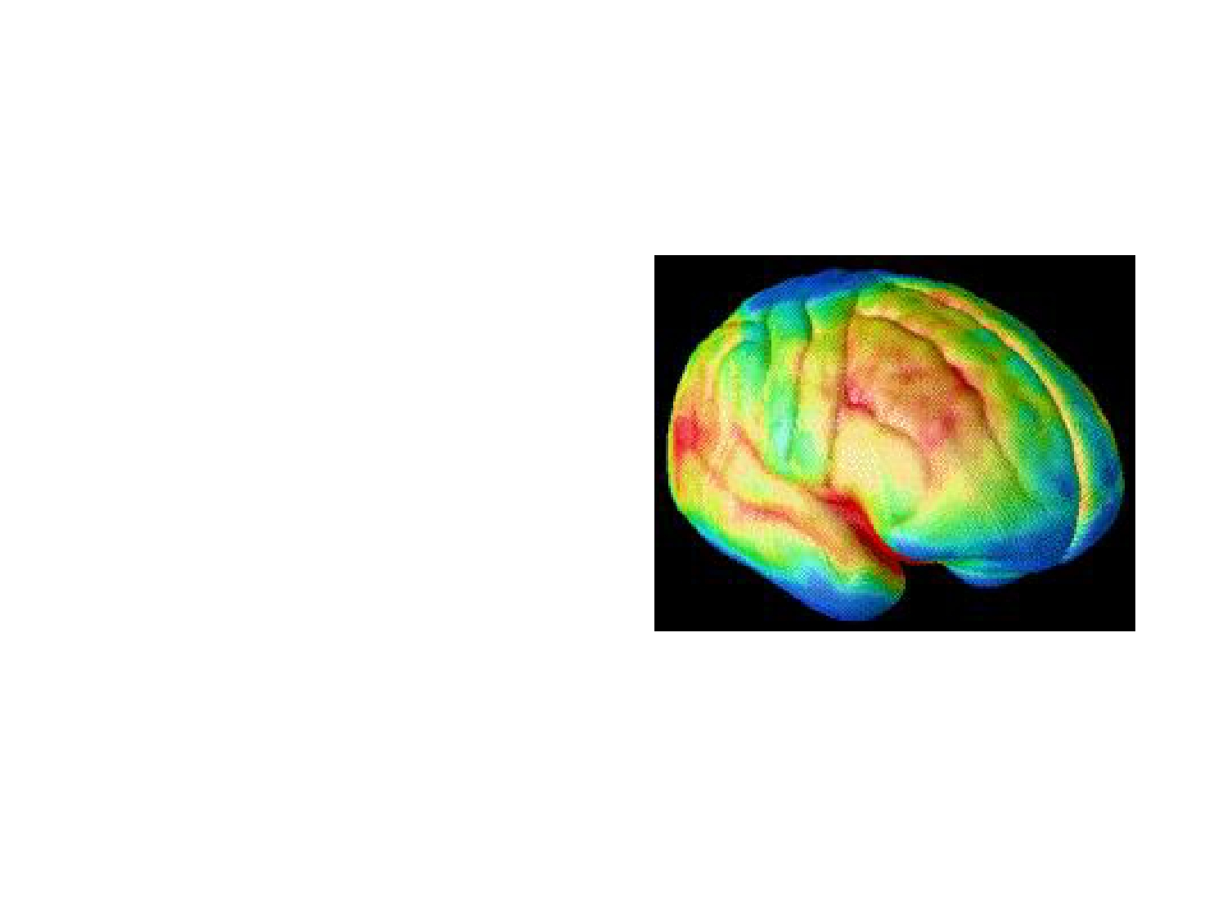
The Results of Synaptic Pruning
Red indicates grey
matter which is mainly
responsible for
information
processing (neuron bodies).
Blue indicates myelination
These changes may parallel a pruning process that that appears to follow the principle of "use-it-or-lose- it:" neural connections, or synapses, that get exercised are retained, while those that don't are lost.

Slide 9
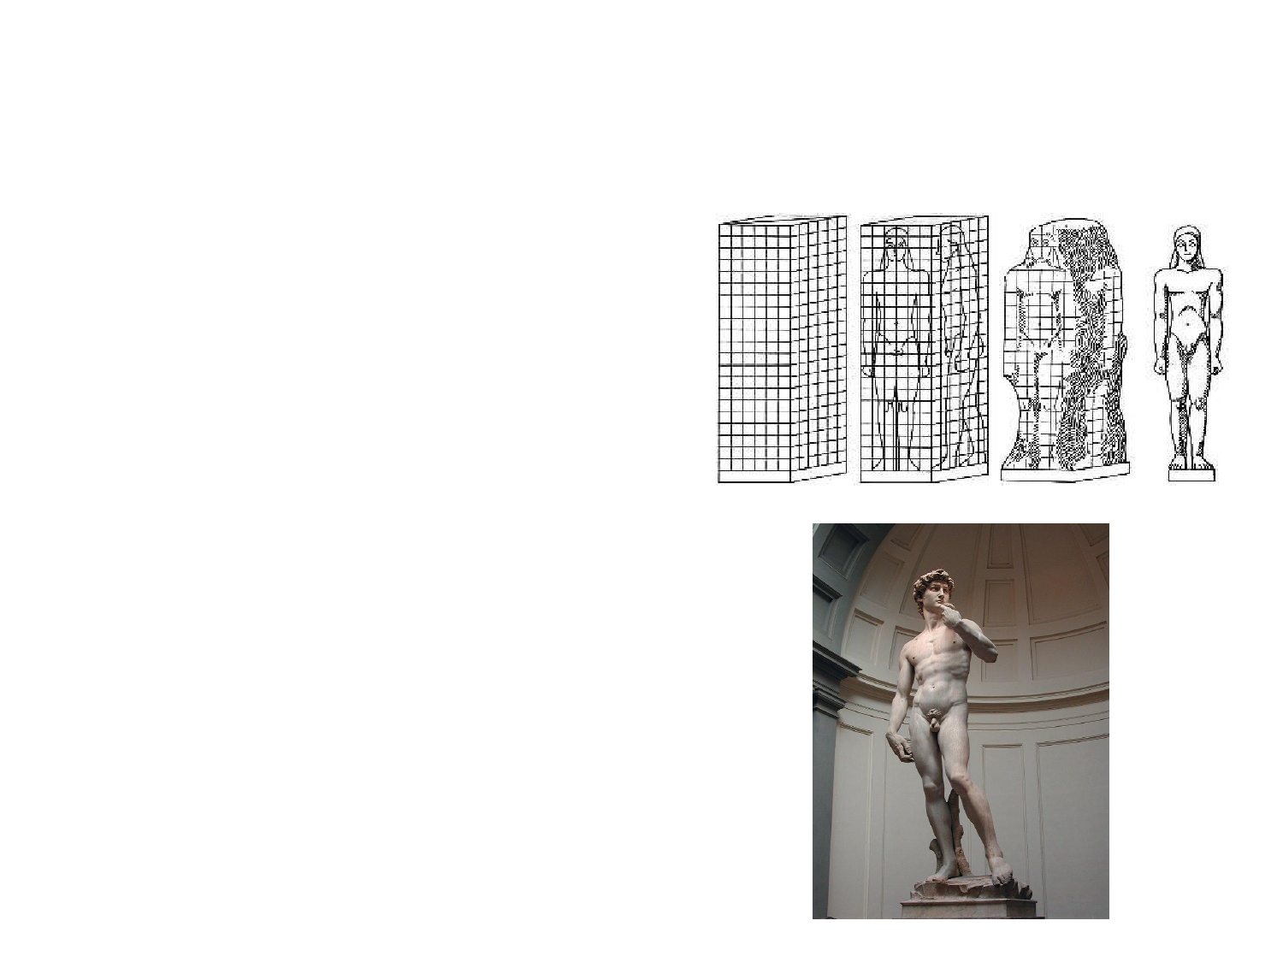
Synaptic Pruning
Researcher Jay Giedd compares this pruning to Michelangelo with a block of marble. He begins to sculpt away until David emerges.
This is precisely what is going on in the adolescent brain, starting around 11. The brain is pruning away, sculpting away excess material, excess connections, to make a more refined, more efficient, more adult brain.

Slide 10
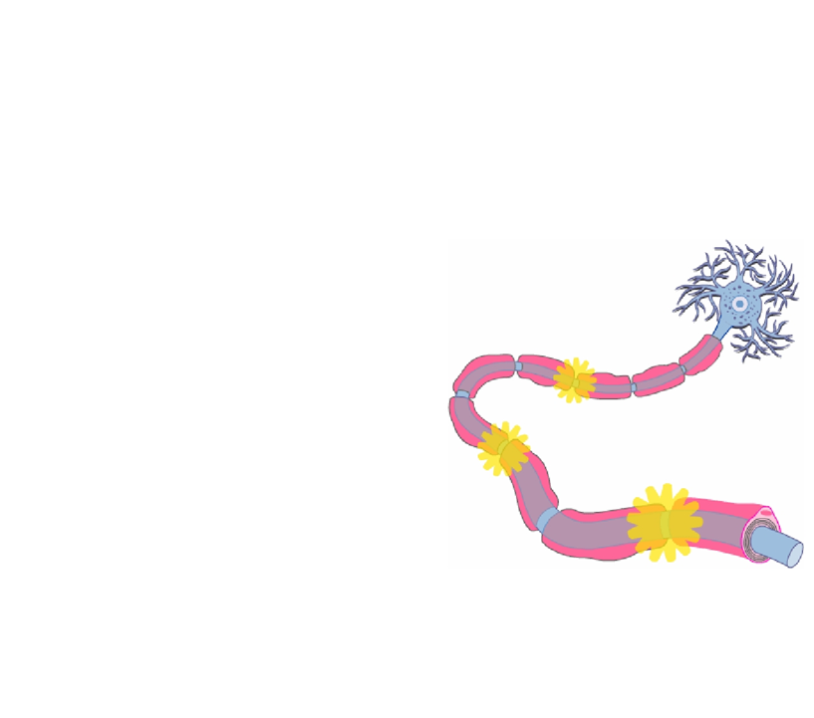
Adolescent Brain Development:
Myelination
The second change is in myelination; in
adolescence, it is not finished. The last part of the brain to myelinate is the frontal lobes. And myelination is not complete in the frontal lobes of the brain until around 18 to 20 or later.
Myelination on a neuron allows it to operate more efficiently.

Slide 11
Adolescent Brain Development:
Myelination
Myelination happens in the temporal and parietal lobes before it happens in the frontal lobes.
What does that mean?
Teens are moving from concrete to abstract thinking.
Teens tend to become very idealistic & cause-oriented.

Slide 12
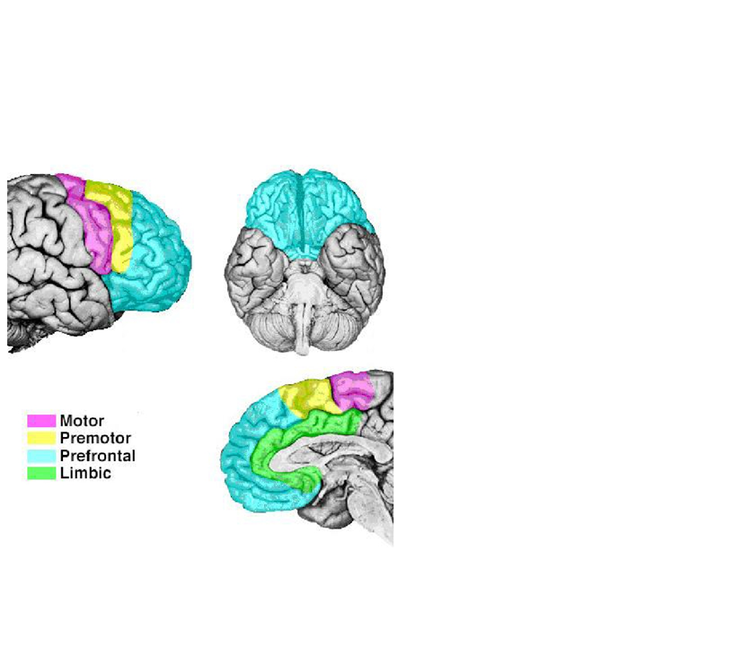
Prefrontal Lobes
The last area of the brain to develop is the prefrontal lobes

Slide 13
Prefrontal Lobes

Slide 14
Prefrontal Lobes
The prefrontal lobes are responsible for:
Goal and priority setting.
Adolescents have a great deal of difficulty prioritizing

Slide 15
Prefrontal Lobes
The prefrontal lobes are responsible for:
• Planning and organization of multiple tasks.
Adolescents have difficulty multitasking.

Slide 16
Prefontal Lobes
The prefrontal lobes are responsible for:
Impulse inhibition
Determining cause and effect relationships
Determining right from wrong
Ability to make sound judgments
Emotional control, the third change in the adolescent brain

Slide 17
Resources
Pat Wolfe, Mind Matters, Inc., Napa, CA: The Adolescent Brain: A Work in Progress
Adolescent Growth and Development Author: Angela Huebner, Assistant Professor and Extension Specialist, Family and Child Development, Virginia Tech
Sam Goldstein, Hardwired to Learn, Learning and the Brain Conference, 2008

